Slide 1


Using AWS Lambda to do cool things
Michael Alberhasky| ITS-AIS
12/21/2017

Slide 2
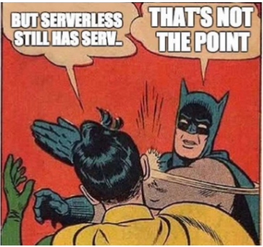
What is serverless computing?
Amazon Web Services (AWS) = Lambda
Azure = Azure Functions
Google Compute Platform (GCP) = Cloud Functions

Slide 3

AWS Lambda
Run code without worrying about servers
Execute based on event triggers from other AWS services
Execute programmatically
Stateless
Think microservices

Slide 4
Lambda Use Cases
S3 new object trigger –> generate thumbnails
EC2 new instance startup –> check required tags
Serverless website –> Lambda API endpoints
Alexa skills
IoT Greengrass runs functions against devices
CloudWatch event fires Lambda function on schedule

Slide 5
Lambda is…
Not meant for long-running processes – max timeout of 300s
Not meant for super large packages – max of 500MB
Not meant for super low-latency requests – cold startup (impacts Java the most)
Faster when you allocate more memory

Slide 6















Lambda-Compatible Events
S3
Cognito
Alexa
DynamoDB
CloudFormation
API Gateway
Kinesis
CloudWatch
IoT
SNS
CodeCommit
CloudFront
SES
Config
Lambda on Demand

Slide 7




Compatible Languages
GoLang, Ruby, PHP support coming

Slide 8
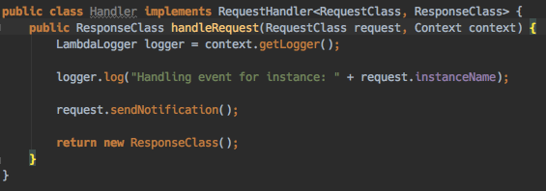
Building Lambda Functions
Handler maps input/output
Context to provide access to Lambda environment
Java: automatically deserializes JSON into POJOs
Function must be built into a ZIP or JAR

Slide 9
Testing always stinks
Not as easy as it should be, but getting better
Best to mock inputs the best you can. Some services you can’t mock (Kinesis).
Save sample test payloads and run test execution against it.
Cloud9 IDE has integrated Lambda testing. Java support lacking.

Slide 10
Deployment options
Upload via the management console
Manage via a CloudFormation Template
Use the Serverless Application Model (SAM) and CloudFormation to define interactions
Via AWS’ code deployment facilities
  CodeBuild
  CodeDeploy
  CodePipeline

Slide 11
Examples
Snowplow Real-time pipeline (Michael)
Weka Model (Jimmy)

Slide 12
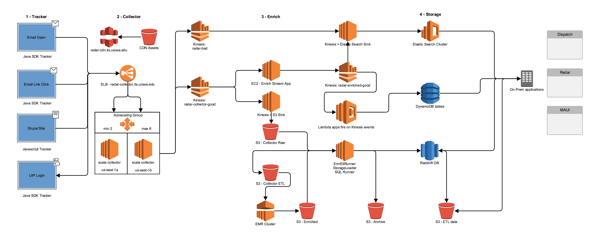
Snowplow Architecture

Slide 13
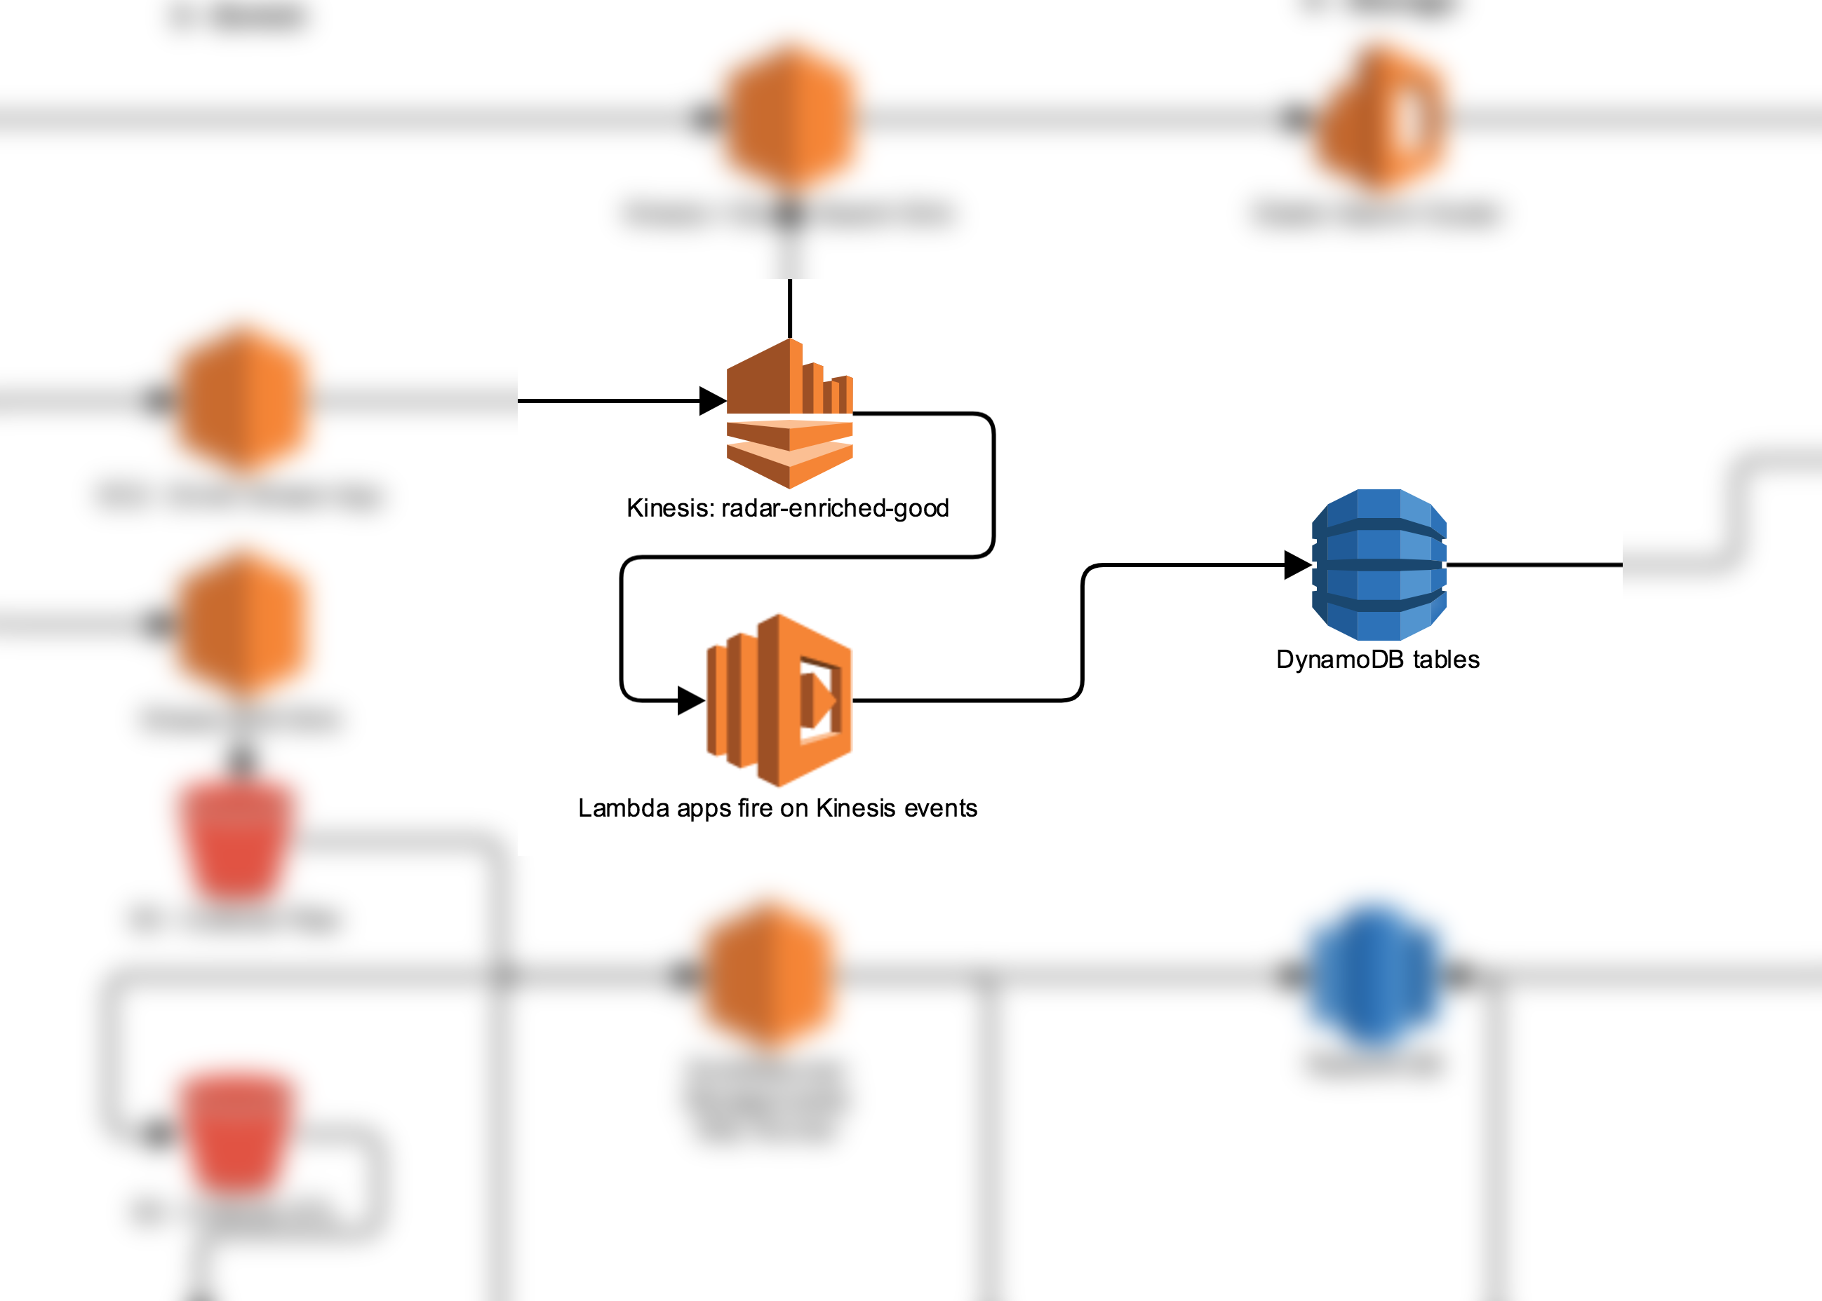
..enhance

Slide 14
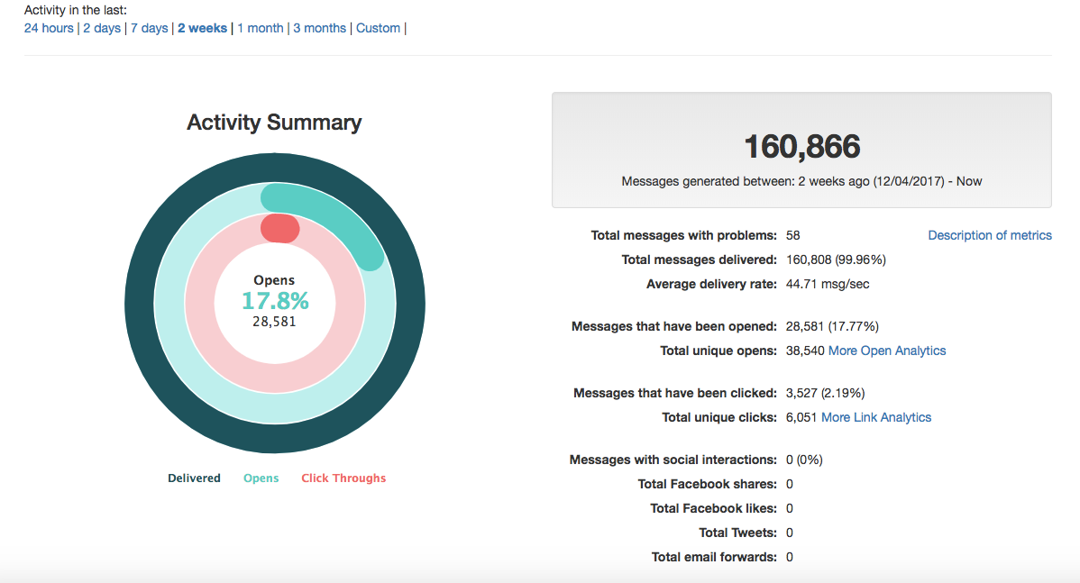
Feeds Analytics to Dispatch

Slide 15
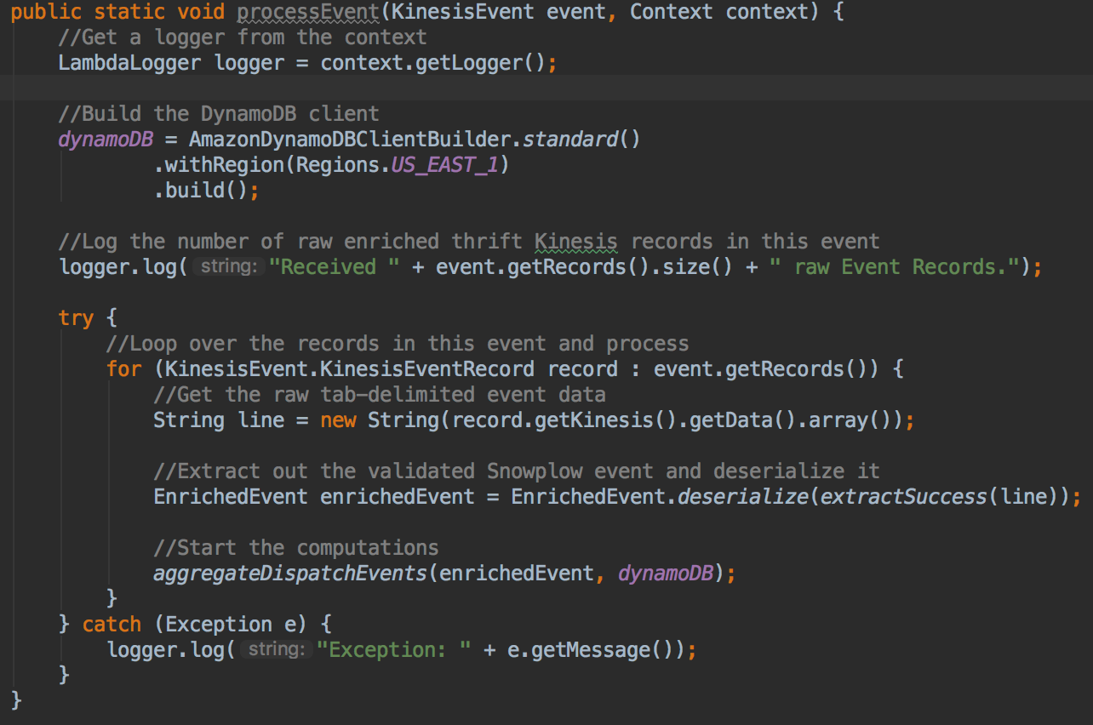
Handler code

Slide 16
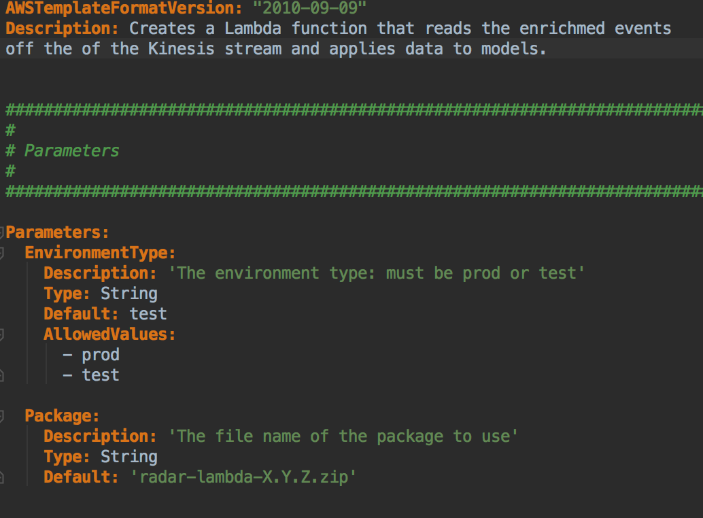
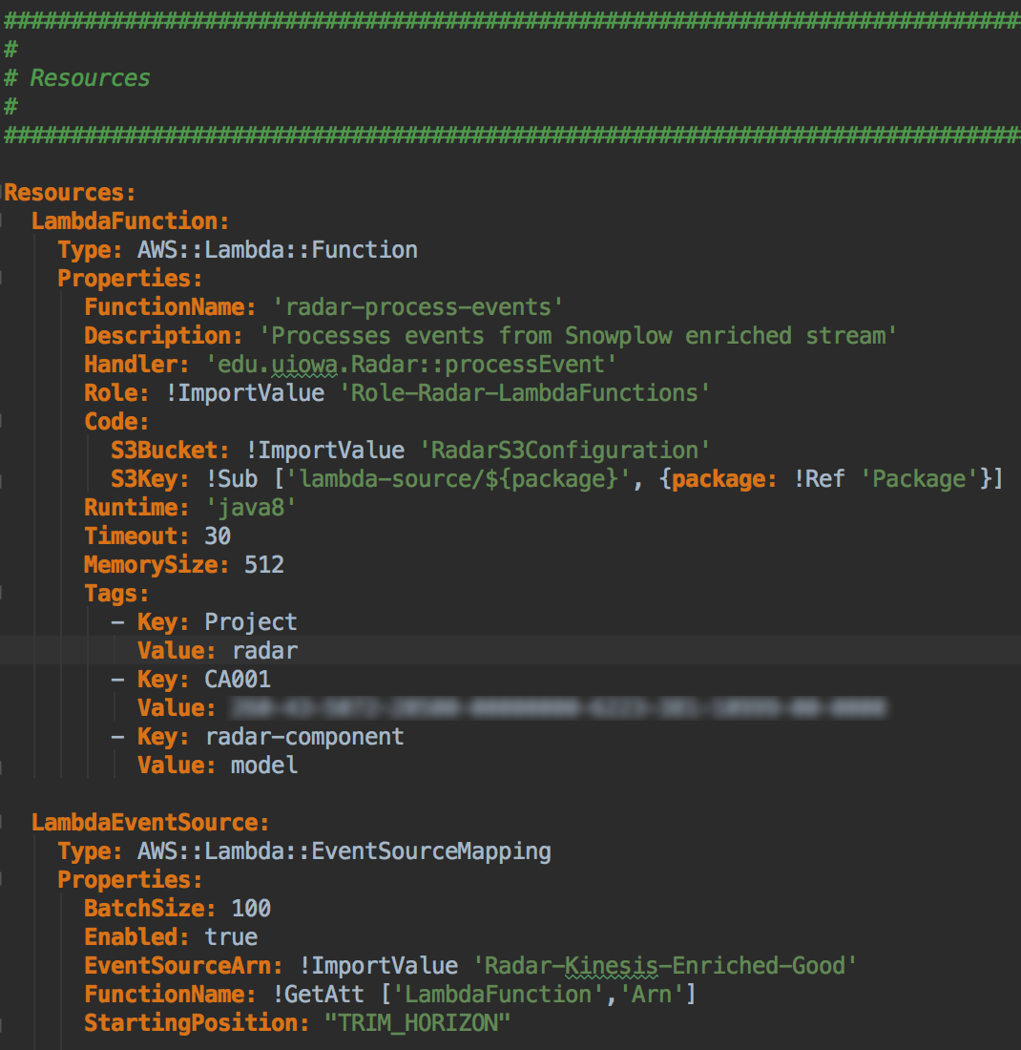
Deploying with CloudFormation

Slide 17
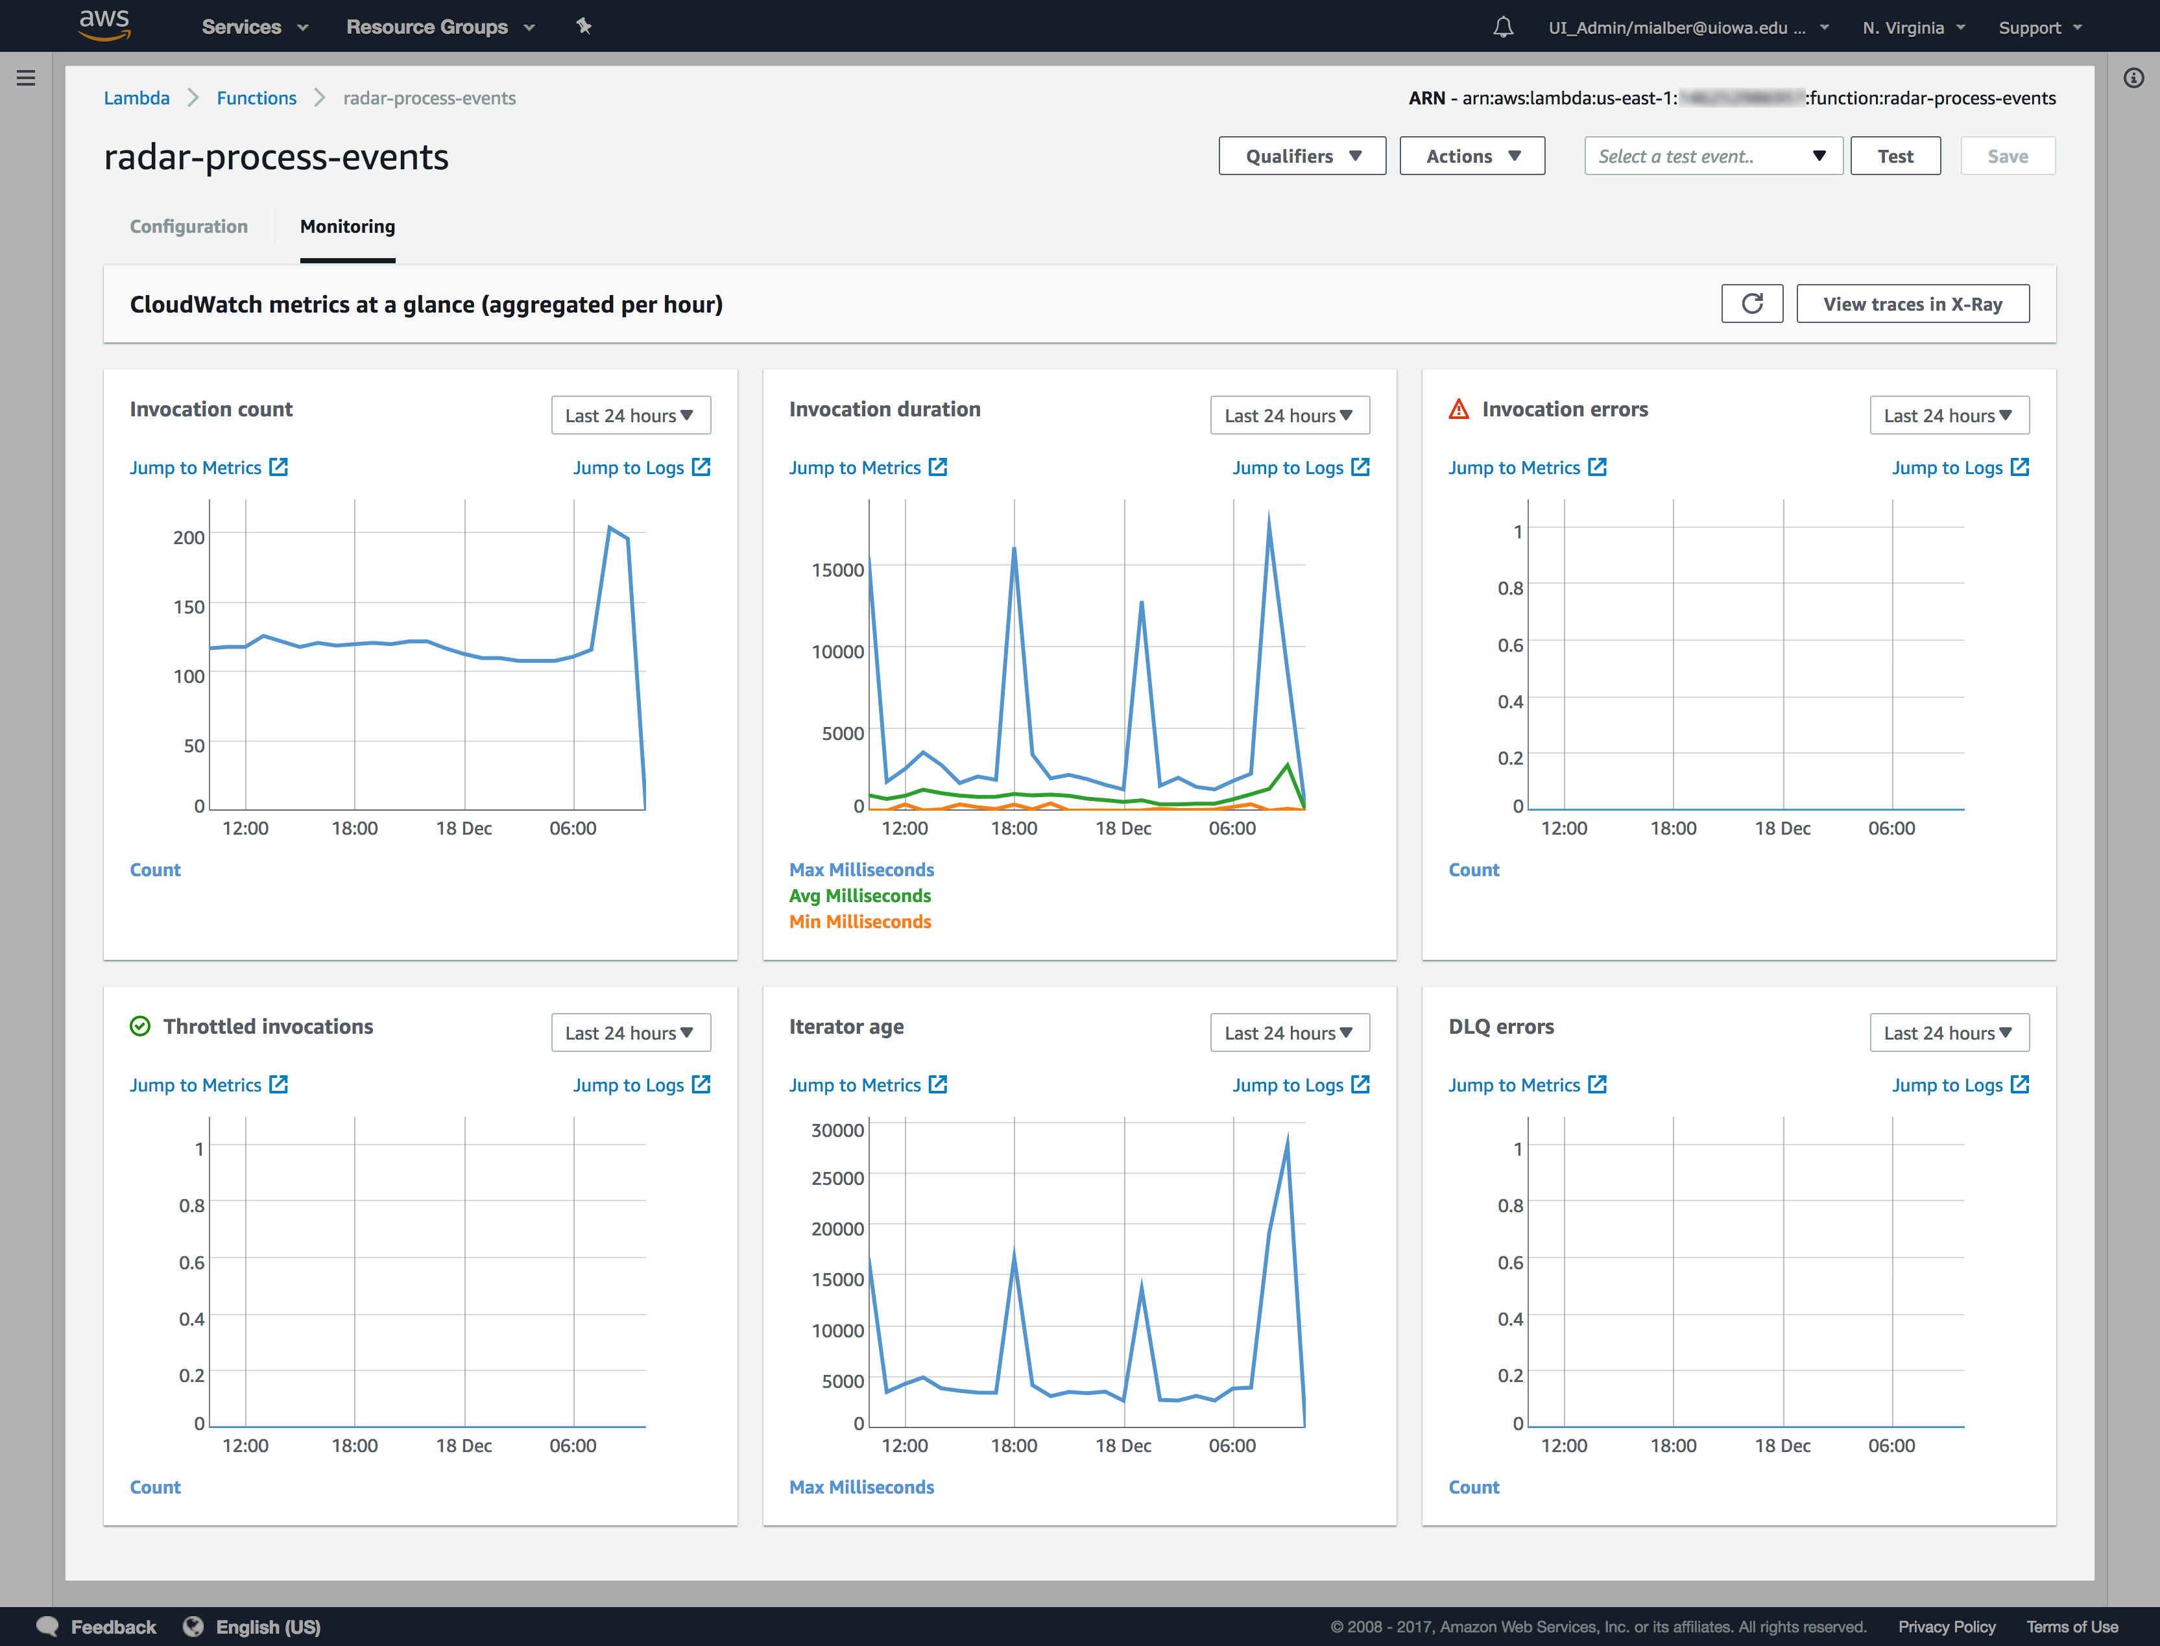
Monitoring
Notes:
Averaging about 300 invocations/hour; averaging 1.2s per invocation

Slide 18
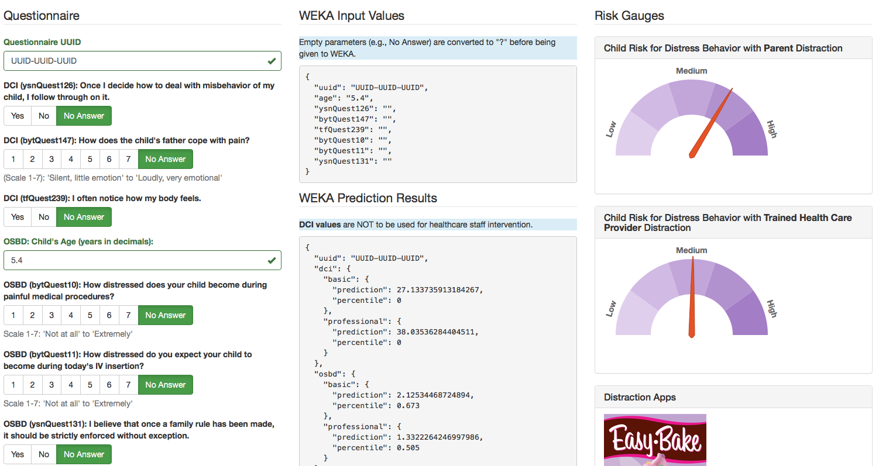
WEKA Predictor Web Service

Slide 19
WEKA Predictor Web Service
INPUT
OUTPUT

Slide 20
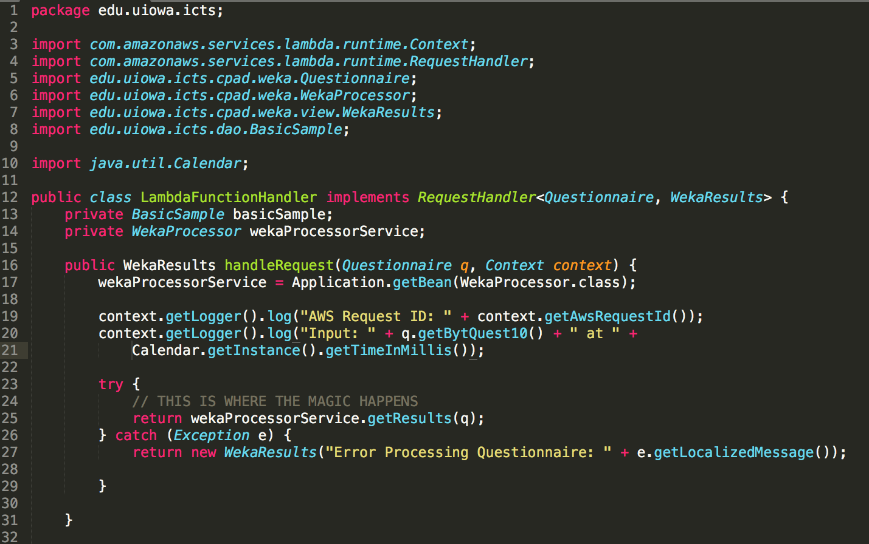
WEKA Predictor Web Service

Slide 21
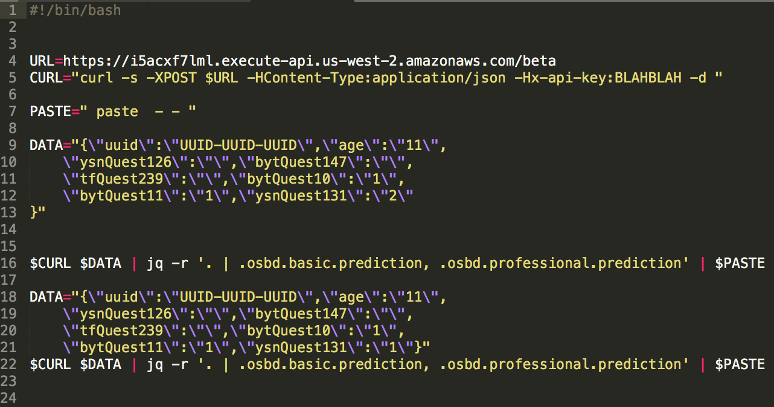
WEKA Predictor Web Service

Slide 22
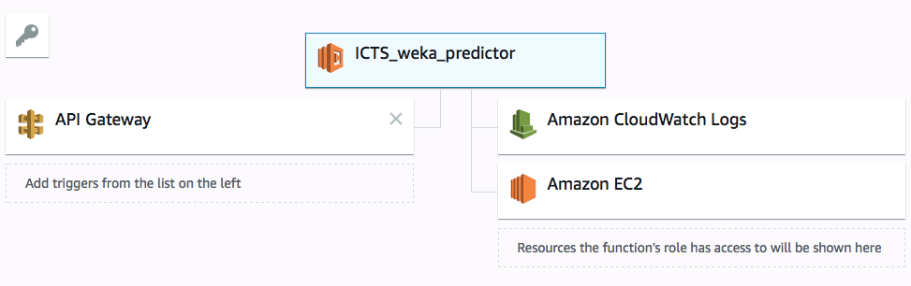
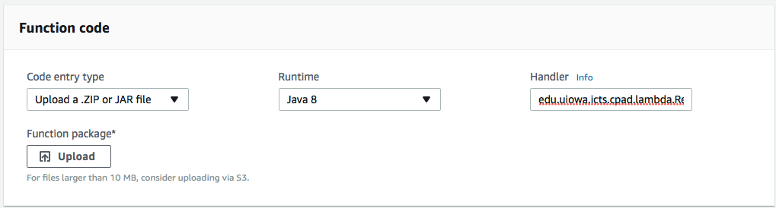
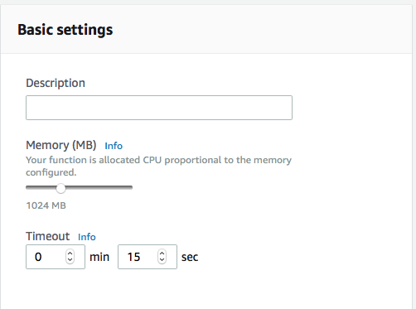
AWS Setup

Slide 23
Response Time & Memory Effects
Response Times
300ms Desktop
250ms VM Server
2500ms 128mb Lambda Process
  Counter intuitive: I thought reducing memory would be good
300ms 1028mb Lambda Process
15s from Cold boot

Slide 24
Questions?
Michael Alberhasky
michael-alberhasky@uiowa.edu
Jimmy Schappet
james-schappet@uiowa.edu
Cloud Services
ITS-Cloud-Services@iowa.uiowa.edu

